Slide 1


Stellar Characteristics in the Milky Way: Unraveling Galactic Mysteries
This study aims to analyse the intrinsic characteristics and properties of stars within the Milky Way to uncover patterns in stellar evolution and distribution. By exploring relationships between key attributes like luminosity and temperature, we seek to deepen our understanding of stellar phenomena, galactic structure, and cosmological evolution. The investigation utilises data from the AT-HYG Database, an extension of the original Tycho Catalogue, offering access to a broader and more accurate dataset covering a wide range of stellar types and distances.
by James Smith
Notes:
Study Focus: Analysing intrinsic characteristics and properties of stars in the Milky Way.
Objective: Explore relationships between attributes like luminosity and temperature.
Importance: Deepen understanding of stellar evolution, galactic structure, and cosmological evolution.
Impact: Refine cosmological models and predict star formation rates and galactic evolution over cosmic timescales.
Exploratory Data Analysis (EDA) aims to summarize the main characteristics of a dataset, often with visual methods. The key objectives include:
Understanding the Data Structure: Identify the types of variables (categorical, numerical) and the relationships among them.
Identifying Patterns and Trends: Detect patterns, trends, and distributions in the data.
Spotting Anomalies: Discover outliers or anomalies that may need further investigation or preprocessing.
Checking Assumptions: Validate assumptions that underpin statistical models and algorithms.
Informing Further Analysis: Provide insights that guide the selection of appropriate statistical tools, machine learning models, or hypotheses for further testing.
Assessing Data Quality: Evaluate the completeness, accuracy, and consistency of the data.
Generating Hypotheses: Develop new hypotheses based on observed patterns and relationships in the data.
EDA is an essential step in the data analysis process, ensuring a comprehensive understanding of the data before applying more complex analytical techniques.

Slide 2

Research Questions
1
Luminosity and Temperature Correlation
How do stellar luminosity and temperature correlate across different types of stars within the Milky Way? We hypothesise a significant correlation between these properties, suggesting common underlying physical processes in stellar evolution.
2
Impact on Galactic Structure
What role do stellar properties play in shaping the structure and dynamics of the Milky Way galaxy? We propose that these properties significantly influence factors such as star formation rates, galactic arms, and overall stellar distribution.
3
Regional Variations
How do the intrinsic characteristics of stars vary across different regions of the Milky Way galaxy? We expect observable patterns or gradients, indicating localized variations in star formation rates, environmental conditions, or evolutionary history.
Notes:
Separated this aim into three distinct research questions or foci
How do stellar luminosity and temperature correlate across different types of stars within the Milky Way, and what does this correlation imply for stellar evolution?
What role do stellar properties (e.g., luminosity) play in shaping the structure and dynamics of the Milky Way galaxy, and how does this contribute to our understanding of galactic evolution?
How do the intrinsic characteristics (luminosity, temperature) of stars vary across different regions of the Milky Way galaxy, and are there observable patterns or gradients indicating localized variations in star formation or environmental influences?

Slide 3
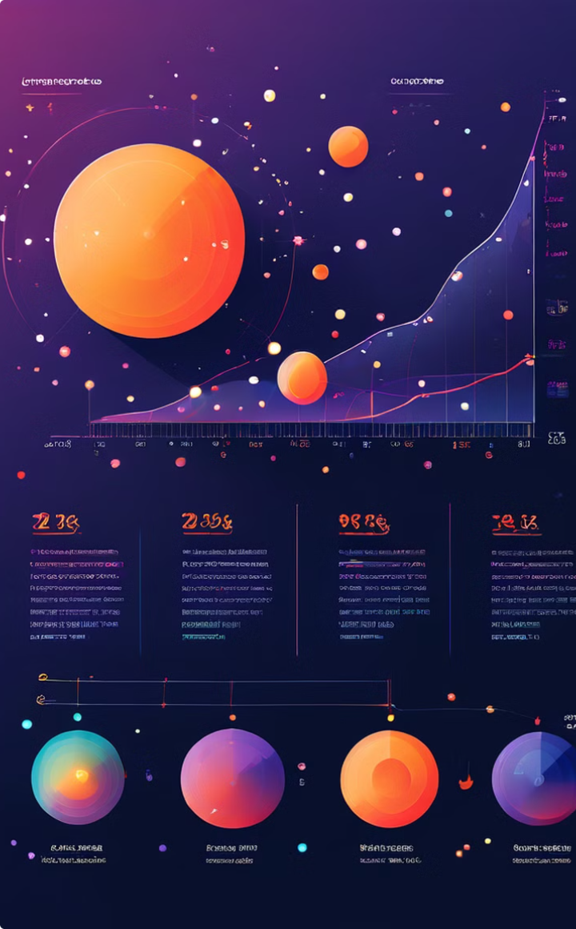
Data Source: AT-HYG Database
The AT-HYG Database represents a significant advancement in stellar catalogues. It incorporates the HYG database (v3.7), Augmented Tycho-HYG (v2.4) catalogs, and the recently released Gaia DR3 (2020-2022) data. This comprehensive dataset provides precise measurements of stellar positions, distances, and motions for over 1.8 billion stars. The database's origins trace back to the Hipparcos mission, launched in 1989 by the European Space Agency (ESA), which aimed to accurately measure stellar positions, distances, and proper motions.
1
1989
ESA launches the Hipparcos mission to measure stellar positions, distances, and proper motions.
2
1997
Release of the Hipparcos Catalogue, forming the basis of the HYG database.
3
2000
Release of the Tycho-2 Catalogue, improving astrometric and photometric data for over 2.5 million stars.
4
2020-2022
Integration of Gaia DR3 data, expanding the database to over 1.8 billion stars with improved precision.
Notes:
Source: Utilizing data from the AT-HYG Database (Augmented Tycho - HYG).
Origin: The HYG database integrates the Hipparcos and Tycho Catalogues, developed by ESA’s Hipparcos mission (1989-1997).
Content: Includes data from the Yale Bright Star Catalogue (5th Edition), enhancing star brightness and spectral type information.
Modern Update: Incorporates Gaia DR3 (2020-2022) data, providing precise measurements for over 1.8 billion stars.
Significance: Offers extensive and accurate data on over 2.5 million stars, crucial for contemporary astronomical research.
Applications: Widely used for studies on stellar populations, evolution, dynamics, nearby stars, and exoplanet candidate identification within the Milky Way.

Slide 4
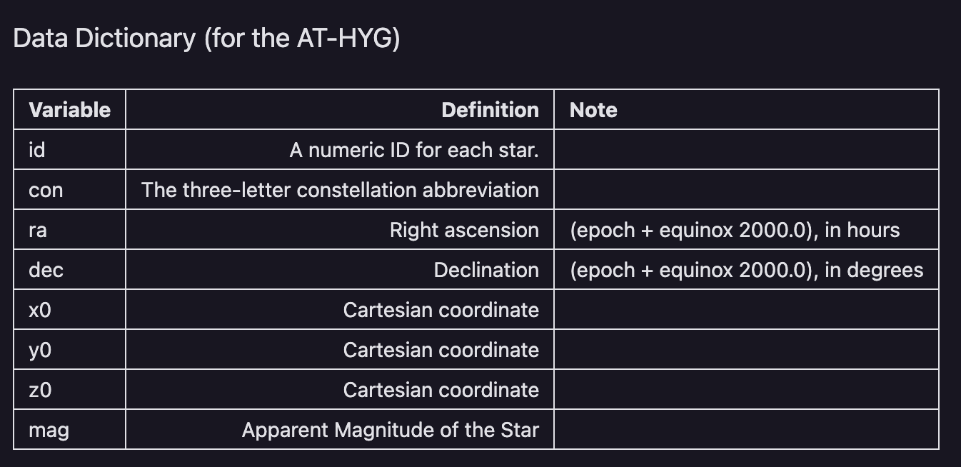
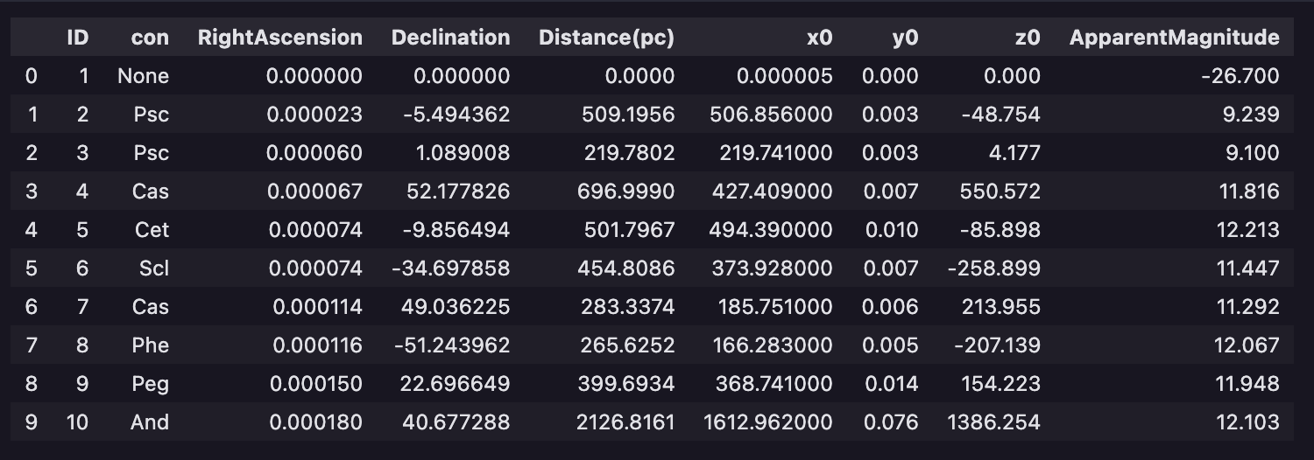
Key Variables
Key Variables
Luminosity (L)
Temperature (T)
Spectral Type
Mass
Radius
Absolute Magnitude
Notes:
For each star the AT-HYG Database included
Unique ID
Associated constellation
Right Ascension and Declination - Right Ascension (RA) is a coordinate used in astronomy to specify the east-west position of a celestial object in the sky. Together with Declination (Dec), which specifies the north-south position, Right Ascension forms the equatorial coordinate system, analogous to longitude and latitude on Earth’s surface.
RA and Dec are used to develop Cartesian coordinates
Apparent Magnitude
Apparent magnitude is a logarithmic scale used to describe the brightness of celestial objects observed from Earth. The scale is reversed: brighter objects have lower (more negative) magnitudes, while dimmer objects have higher (less negative or positive) magnitudes.
The apparent magnitude of the Sun, as seen from Earth, is approximately -26.74.
From this variable (apparent magnitude) the other key variables were derived using well known astronomical formula
Absolute Magnitude – which is the apparent magnitude an object would have if it were placed at a standard distance of 10 parsecs (about 32.6 light-years) from Earth.
absolute magnitude provides a standardized measure of the true brightness of celestial objects, essential for studying their physical properties and evolutionary stages. On the same scale as apparent magnitude
From this I calculated luminosity which refers to the total amount of energy emitted by a celestial object per unit time.
This enabled estimates of radius and mass
Using all of these variables we could determine the stars temperature
Finally, once we had all of this information for the data set, I could classify the stars into Spectral Types
refers to a classification system that categorizes stars based on the characteristics of their spectra, which is the distribution of light intensity at different wavelengths.
Spectral type provides essential information about a star’s physical properties, such as its temperature, luminosity class, and composition. It is crucial for understanding stellar evolution, composition of stellar atmospheres, and population statistics within galaxies.
Evolutionary Significance: Stars of different spectral types undergo different stages of evolution and exhibit unique characteristics in terms of size, colour, and energy output over their lifetimes.

Slide 5





Feature Engineering
Absolute Magnitude Calculation
Calculated using apparent magnitude and distance: M = m - 5 · (log₁₀(d)) + 5
Luminosity Estimation
Estimated using absolute magnitude: L/L₀ ≈ (M/M₀)³·⁵
Radius Estimation
Estimated using luminosity: R/R₀ ≈ (M/M₀)⁰·⁸
Temperature Calculation
Calculated using luminosity and radius: T = (L/(4πR²σ))¹/⁴

Slide 6
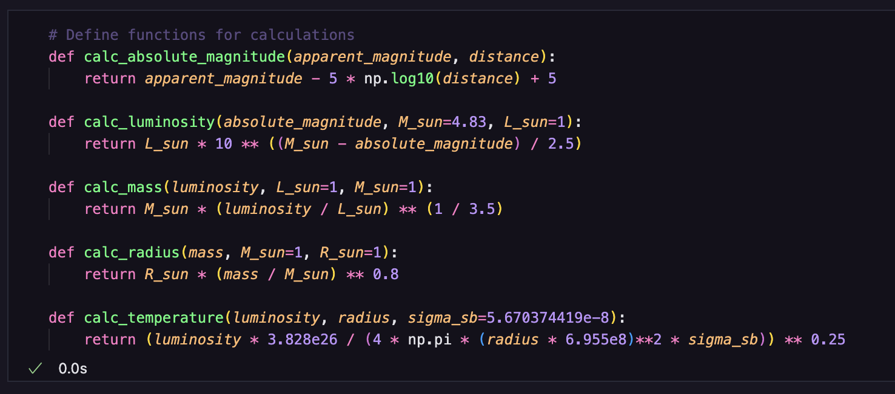
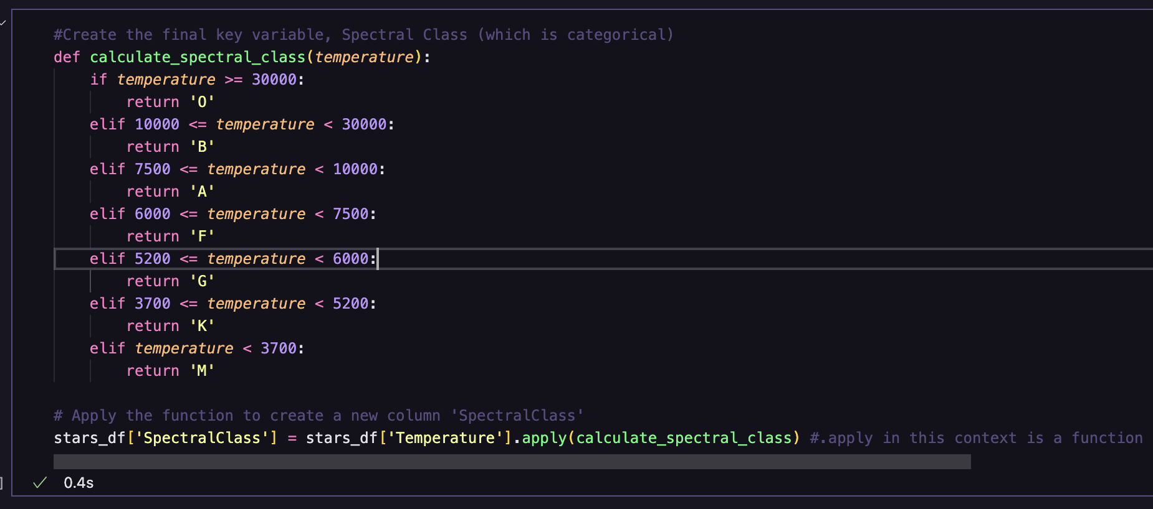
Feature Engineering

Slide 7
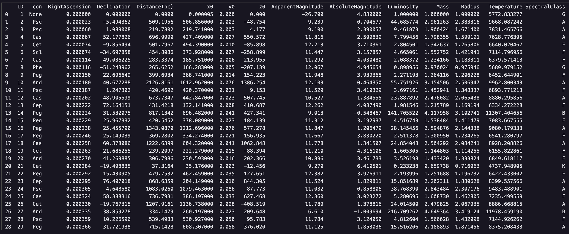
Feature Engineering

Slide 8
Key Variables and Methodologies
Methodologies
Correlation Analysis
Spatial Analysis
Cluster Analysis
Comparative Analysis
Notes:
Similar research has addressed these astronomical questions using methodologies such as this
Methodologies:
• Research Question 1: Stellar Luminosity and Temperature Correlation
• Correlation Analysis:
• Calculate correlation coefficients (e.g., Pearson) to measure the relationship between luminosity and temperature.
• Analyse across different star types (main sequence, giants, white dwarfs) to understand common patterns in stellar evolution.
• Research Question 2: Role of Stellar Properties in Galactic Structure
• Spatial Analysis and Cluster Analysis:
• Use spatial visualization techniques to map stars based on their luminosity and temperature profiles across the Milky Way.
• Apply clustering algorithms to identify groups of stars influencing galactic structure and dynamics.
• Research Question 3: Variations in Intrinsic Characteristics across Galactic Regions
• Spatial Analysis and Comparative Analysis:
• Utilize spatial mapping techniques to visualize variations in luminosity and temperature across different galactic regions.
• Conduct comparative analyses to detect statistically significant differences in intrinsic characteristics between regions, aiding in understanding local variations in stellar properties within the Milky Way.

Slide 9

Potential Challenges and Limitations
Data Completeness and Bias
The AT-HYG Database covers a specific region of the sky, potentially limiting the generalizability of findings to the entire Milky Way galaxy.
Measurement Uncertainty
Distance measurements in astronomy carry inherent uncertainties, affecting calculations of stellar properties like luminosity.
Selection Effects
The dataset may favour brighter or nearer stars due to observational limits, potentially skewing analyses of stellar populations.
Astronomical Data Complexity
Inherent complexities in astronomical data collection, including observational constraints, must be carefully considered in result interpretation.
Notes:
Data Completeness and Bias:
The AT-HYG Database integrates data from various sources but may have biases.
It covers a specific region of the sky, limiting its generalizability to the entire Milky Way.
Variations in stellar populations across different regions may affect broader applicability without further research.
Uncertainty:
• Distance measurements in astronomy still have uncertainties.
• These uncertainties impact calculations of stellar properties like luminosity.
• Acknowledging these uncertainties is crucial for accurate interpretation of results.
Selection Effects:
• The dataset may favour brighter or nearer stars due to observational limits.
• This could skew analyses of stellar populations across the Milky Way.
• Understanding these effects is essential for making generalizations from the data.
Nature of Astronomical Data:
• Astronomical data collection involves complexities such as observational constraints and distance measurement uncertainties.
These factors are inherent in studying celestial objects and must be carefully considered when interpreting findings.

Slide 10
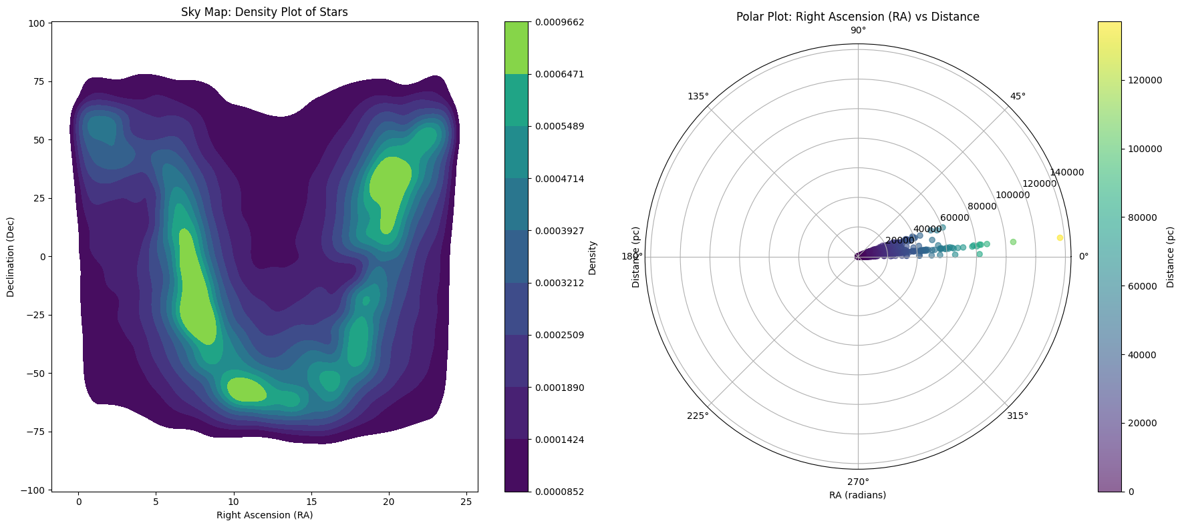
Potential Challenges and Limitations
Notes:
Sky Map
This density plot illustrates the spatial distribution of stars across the sky, characterised by their Right Ascension (RA) and Declination (Dec).
The colour gradient represents star density, with lighter shades (green to yellow) indicating higher concentrations of stars and darker shades (purple) indicating lower densities. These density variations highlight regions of astronomical interest, such as star clusters or parts of the Milky Way.
The plot reveals non-uniform star distribution across RA and Dec, suggesting areas of higher and lower star concentrations. These variations may stem from actual astronomical phenomena, observational biases, or data collection limitations. Overall, the density plot provides a visual insight into the spatial distribution of stars in the observed sky region, aiding astronomers in studying celestial structures and phenomena.
The celestial equator sits at 0 degrees Dec, with the North Celestial Pole at +90 degrees Dec and the South Celestial Pole at -90 degrees Dec. Together, RA and Dec pinpoint the exact locations of celestial objects.
*Note:* When plotting Density maps with seaborn’s kdeplot, the colours on the plot (represented by the colour bar) are typically scaled to the range of the data that is being visualised. This normalisation process ensures that the colours effectively represent the relative density or intensity of the plotted variable across the dataset. So the values of the colour bar scale do not directly correspond to the absolute values of the variable in question, but instead reflect how these values are distributed relative to each other within the plot.
Polar Plot
Angular Axis/ Radial Distance: The radial axis measures the distance of each star from the Earth-Sun system in parsecs (pc). The plot’s centre represents 0 parsecs, the location of our solar system. As you move outward, the radial grid lines depict increasing distances from Earth.
Radial Axis/ Angular Coordinate: This axis represents Right Ascension (RA) measured in radians, covering the full 360 degrees of the celestial sphere converted into radians (0 to 2\pi radians). Each angle around the circle corresponds to a direction in the sky.
The plot depicts stars as points, where each point’s distance from the centre indicates its distance from Earth, and its angle around the centre shows its RA. The colour of each point further denotes its distance, as indicated by the colour bar scale.
Analysis of Star Distribution:
• High Concentration Near the Center:
• Dense clustering of stars near the plot’s center suggests many stars are relatively close to Earth.
• This is typical since closer stars are more easily observed and cataloged.
• Density Decreases Outward:
• Star density diminishes moving outward from the center.
• Reflects fewer observed stars at greater distances due to observational constraints and natural star distribution.
• Observational Bias:
• Plot highlights bias where nearer stars are more readily detected and cataloged.
• Common in astronomical surveys, affecting perceived star density and distribution.
• Focused RA Range (0 to 45 degrees):
• Star concentration between 0 and 45 degrees RA indicates a specific observational focus or dataset limitation.
• May align with primary interest area, instrument limitations, or survey scope.
• Dataset Scope:
• Dataset covers a defined sky region, particularly within 0 to 45 degrees RA.
• Advantageous for detailed studies in this specific celestial segment.
• Implications for Sky Coverage:
• Restricted RA range suggests a bias towards this particular sky region.
• For broader coverage, additional data from other RA segments is essential.
These points provide insights into the spatial distribution of stars, highlighting observational biases and dataset characteristics in astronomical studies.

Slide 11

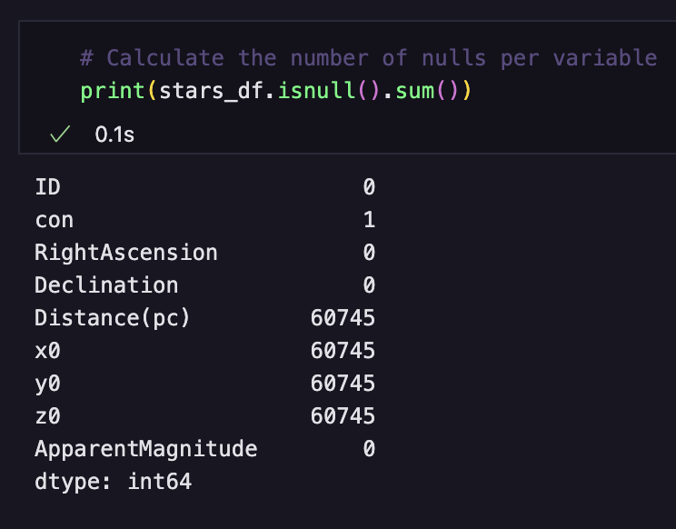
Null Values in Distance
Notes:
Distance Data and Impact:
• Key Issue:
• Distance cannot be computed from the available variables in the dataset.
• Without distance information, it is impossible to accurately calculate critical variables like Absolute Magnitude, Luminosity, Mass, Radius, and Temperature.
• Importance of Distance:
• These variables are crucial for understanding the physical characteristics and properties of stars.
• Assessment Before Deletion:
• Evaluate the impact of missing distance data on the overall dataset.
• Examine the proportion of null values per constellation.
• This assessment helps determine if specific regions of the sky or types of stars are disproportionately affected by missing distance data before deciding to delete rows with missing values.

Slide 12
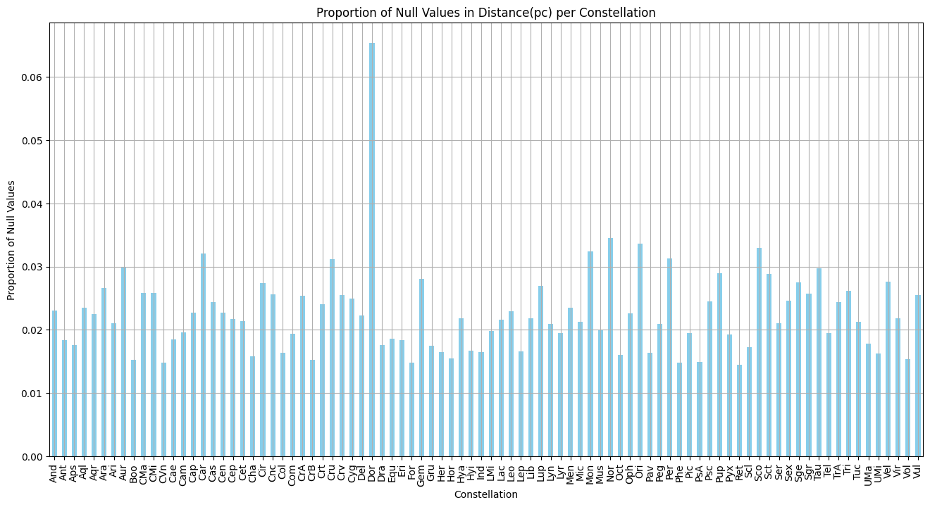
Null Values in Distance
Notes:
The null values within the distance variable are distributed across various constellations, suggesting that their deletion should not significantly compromise the representativeness of the dataset. That is, The absence of distance values spans multiple constellations, implying that the deletion of these rows would not disproportionately affect any particular segment of the sky or type of star. Furthermore, removing rows with missing distance values ensures the integrity of calculations for crucial variables such as Absolute Magnitude, Luminosity, Mass, Radius, and Temperature, which are essential for accurate astronomical analyses.

Slide 13

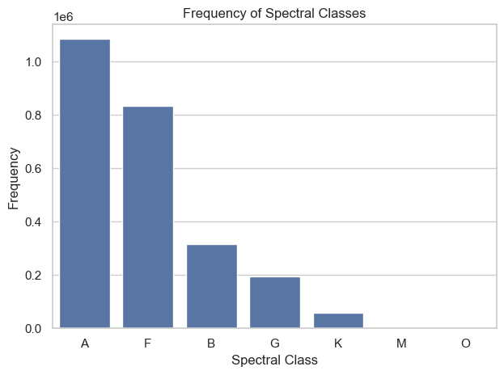
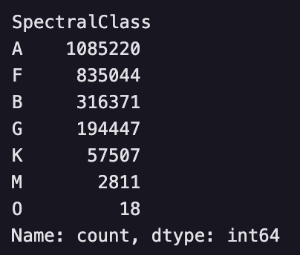
Descriptive Statistics
Notes:
This distribution shows how often each spectral class appears in the dataset, with Class A and Class F being the most frequent, and Class O being the least frequent.
Spectral classes categorise stars based on their spectral lines, which are indicative of their surface temperature and composition.
Based on the frequencies observed for each spectral class, the dataset appears to be skewed towards certain classes, particularly A and F, which are typically much more prevalent compared to classes like M and especially O, which are very rare. This uneven distribution of spectral classes in astronomical data, such as the prevalence of A and F types compared to the rarity of M and O types, may appear non-representative.
However, this distribution accurately mirrors the natural diversity of stars observed in the universe. Stars form under varied conditions and evolve differently over billions of years, leading to a range of spectral types based on factors like temperature and luminosity. This observed distribution aligns with both theoretical models of stellar evolution and extensive observational data collected from astronomical surveys, reflecting the inherent complexities and natural variation of stellar populations across the cosmos

Slide 14

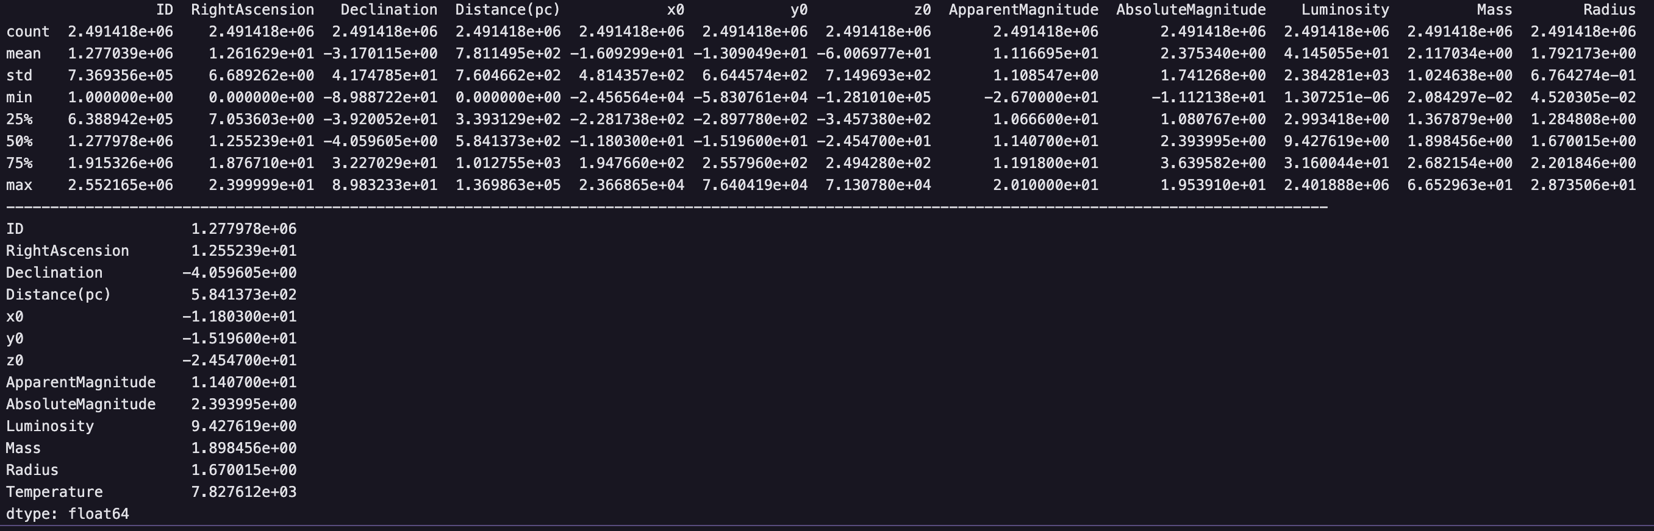
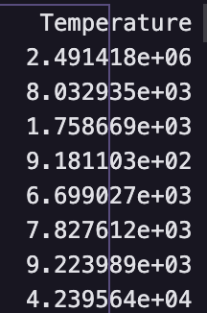
Descriptive Statistics
The descriptive statistics above imply that this dataset contains a wide range and comprehensive view of various stellar properties. Notable observations include:
Distance (pc): Stars range from 0 to 136,986.3 parsecs, with a median of 584.14 parsecs, indicating a broad spatial distribution.
Apparent Magnitude: Ranges from -26.7 to 20.1, with a median of 11.41, indicating the inclusion of both very bright and faint stars.
Absolute Magnitude: Varies from -11.12 to 19.54, with a median of 2.39, suggesting a diverse set of stellar brightness levels.
Luminosity: Spans from 1.31e-06 to 2,401,888, with a median of 9.43, reflecting a wide spectrum of energy outputs.
Mass and Radius: Stellar masses and radii range significantly, with medians of 1.90 and 1.67, respectively, indicating a varied sample of star sizes.
Temperature: Temperatures vary from 918.11K to 42,395.64K, with a median of 7,827.61K, covering a broad range of stellar temperatures.
Notes:
The differences between mean and median values for certain variables indicate potential skewness in the data, suggesting that some stars possess extreme values that influence the mean. This skewness should be taken into account during analysis to ensure accurate interpretations. Overall, the dataset is well-suited for studying the relationships between these stellar properties and understanding the structure and evolution of stars within the Milky Way.

Slide 15
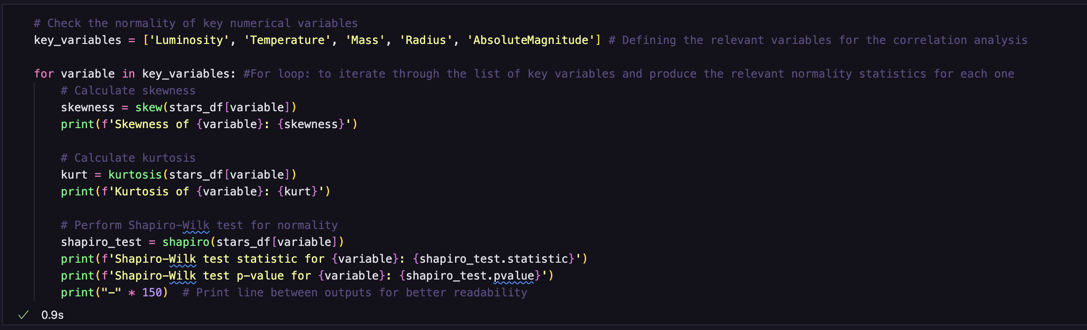
Descriptive Statistics
Notes:
Ran Shapiro-Wilk test, as well as analysis of Skew and kurtosis to assess the normality of each variable in the dataset

Slide 16

Descriptive Statistics
Luminosity:
• High Skewness: Extremely high positive skewness (γ₁ = 838.034) indicates a long tail on the higher end.
• High Kurtosis: Extremely high kurtosis (γ₂ = 813746.973) suggests many extreme outliers, creating a very peaked distribution.
• Shapiro-Wilk Test: Significant deviation from normal distribution (W = 0.0014, p = 5.35e-249).
Temperature:
• Moderate Skewness: Positive skewness (γ₁ = 0.678) indicates a moderate right skew.
• Slightly Elevated Kurtosis: Kurtosis (γ₂ = 1.723) suggests somewhat heavier tails than normal.
• Shapiro-Wilk Test: Deviates from normal distribution (W = 0.974, p = 2.15e-121), though less severely than Luminosity.
Mass:
• Right Skew: Positive skewness (γ₁ = 2.465) indicates a right skew.
• Significant Outliers: High kurtosis (γ₂ = 37.286) suggests heavy tails and significant outliers.
• Shapiro-Wilk Test: Not normally distributed (W = 0.879, p = 3.45e-169).
Radius:
• Right Skew: Positive skewness (γ₁ = 1.487) indicates a right skew.
• Heavier Tails: Elevated kurtosis (γ₂ = 10.547) suggests heavier tails and more outliers.
• Shapiro-Wilk Test: Significant deviation from normal distribution (W = 0.926, p = 6.73e-153).
Absolute Magnitude:
• Slight Positive Skew: Skewness (γ₁ = 0.091) indicates a slight right skew.
• Slightly Peaked: Kurtosis (γ₂ = 0.410) suggests a slightly peaked distribution with fewer outliers.
• Shapiro-Wilk Test: Significant deviation from normal distribution (W = 0.993, p = 1.37e-84).
Notes:
• For large sample sizes (n > 5000), Shapiro-Wilk test p-values may be inaccurate.
• With a sample size of 2,491,420, visual inspection is recommended to assess normality.
Used Shapiro-Wilk to support the visual interpretation because variables were so skewed (drastic outliers) that many did not appear on the plot (basically lots of data and lots of very big outliers made it hard to visualise)..

Slide 17
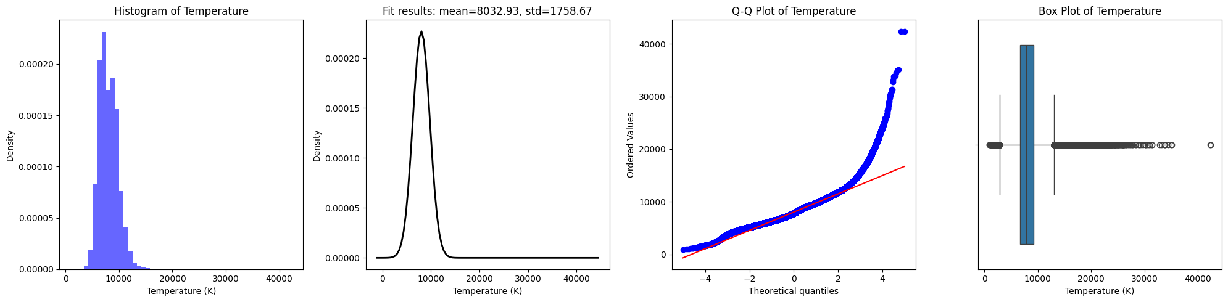
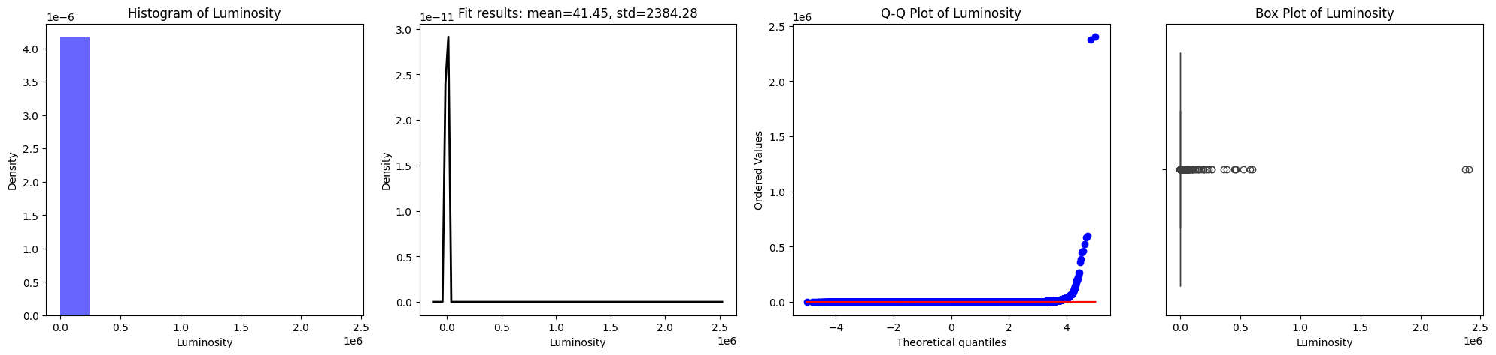
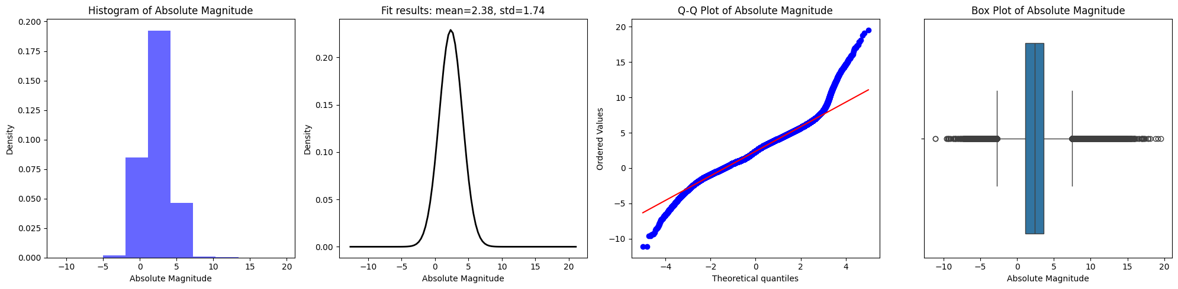
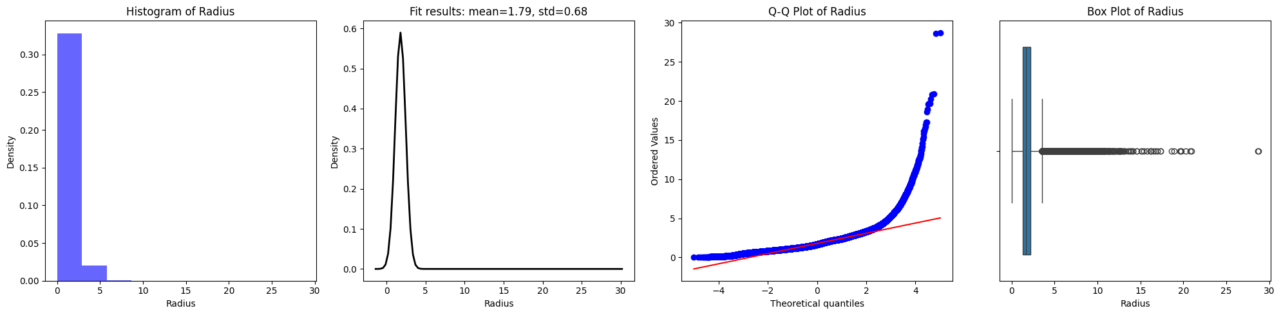
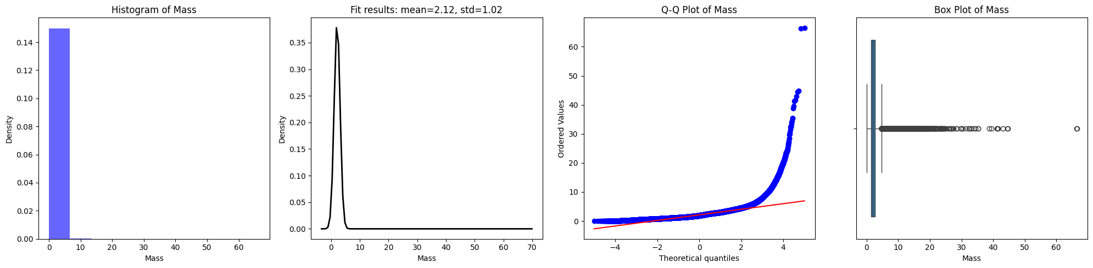
Distribution Analysis
Notes:
Visually represented here.
All variables were significantly skewed – so much so that it is actually hard to see in these plots (we would need to zoom in a lot)
So, ran a box-cox transformation and attempted to normalize the data

Slide 18
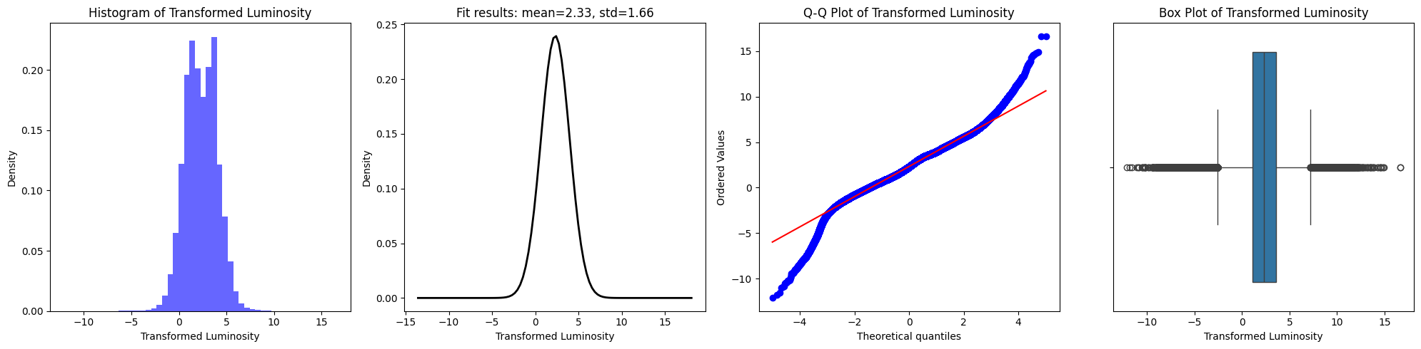
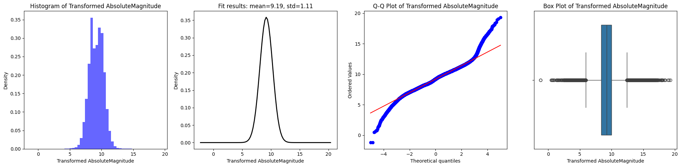
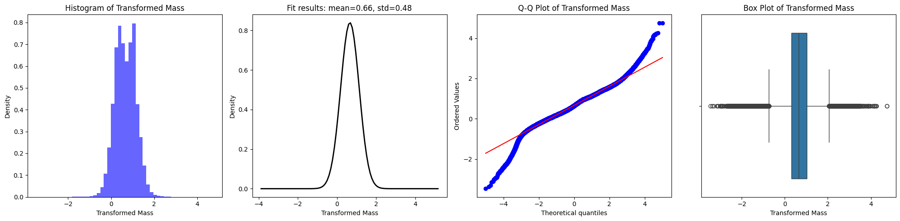
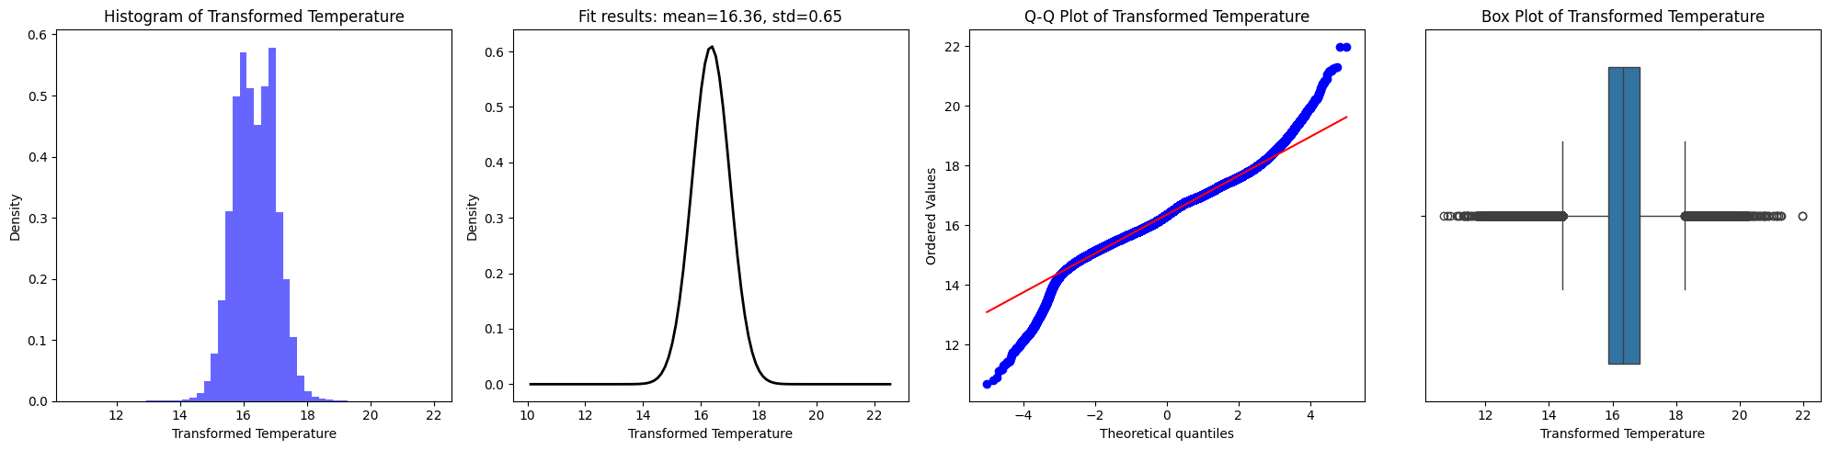
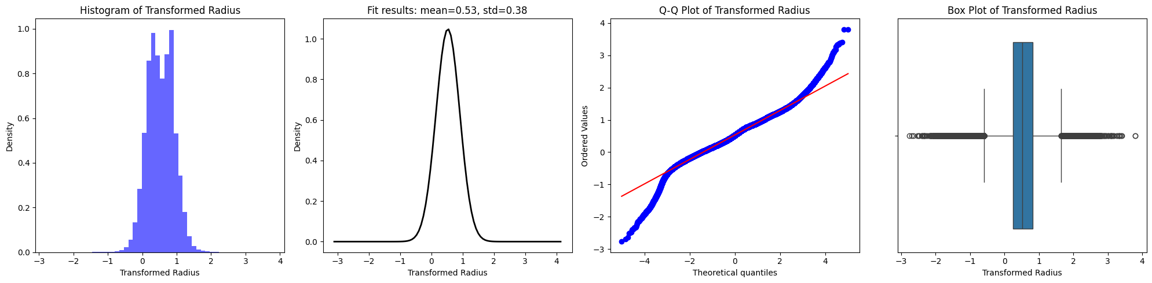
Distribution Analysis
Notes:
These are the same variable distributions after the box-cox transformation
These new values suggest that the Box-Cox transformations have normalized the skewness and kurtosis values significantly close to zero, indicating a much more symmetric and less peaked distribution compared to the original data.
However, the Shapiro-Wilk test results for each transformed variable show very small p-values, indicating strong evidence against the null hypothesis of normality.
This suggests that even after transformation, the data deviates significantly from a normal distribution, likely due to the large sample size, where small deviations from normality can still yield very low p-values.
These results suggest that while the Box-Cox transformations have helped in reducing skewness and kurtosis, the data still might not be normally distributed, which is important to consider when deciding upon further analytical techniques.
Absolute magnitude was near normal
Absolute Magnitude:
• Skewness (γ₁ = 0.012): Indicates very slight skewness, suggesting a near-normal distribution with a minimal tendency towards higher values.
• Kurtosis (γ₂ = 0.357): Indicates a platykurtic distribution, meaning fewer outliers and a less peaked shape compared to a normal distribution.
• Shapiro-Wilk Test (W = 0.994, p = 6.24e-83): Indicates that the transformed Absolute Magnitude data is very close to a normal distribution. The p-value suggests strong evidence against the null hypothesis of normality, so we conclude that the data significantly deviates from a normal distribution, despite being close to it.
• Conclusion: The transformed Absolute Magnitude data shows a nearly normal distribution with minimal skewness and kurtosis, supported by the Shapiro-Wilk test indicating a departure from normality but still very close to it.

Slide 19

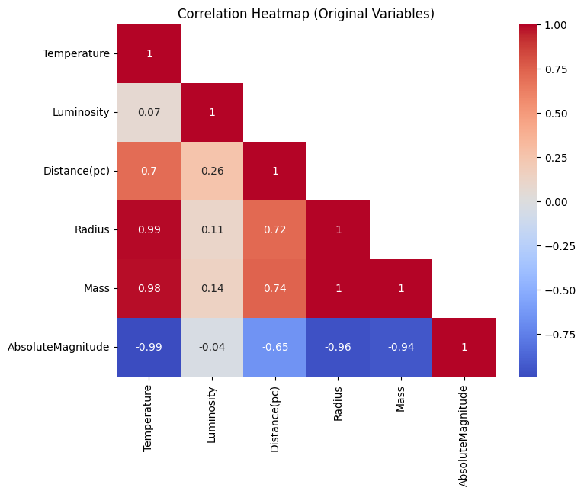
Correlation
Notes:
Used original variables because transformed variables didn’t achieve normality anyway.
The original variables also supported better interpretability and easier comparison to similar other studies.
Online sources also indicated
During the initial exploratory data analysis (EDA), it might be useful to look at the correlations with the original variables to understand their raw relationships.
If transformations introduce complexities that do not significantly improve the analysis, it might be more practical to stick with the original variables.
From this heat map it is immediately obvious that the variables (Temperature, Luminosity, Radius, Mass, and Absolute Magnitude) show strong interdependencies, reflecting the complex physical relationships among stars of different types and sizes in the dataset.
Temperature and Luminosity: There is a very weak positive correlation ( r = 0.07 ), indicating that as temperature increases, there is a slight tendency for luminosity to also increase.
Distance (pc) and Temperature/Luminosity: Distance shows moderate positive correlations with both Temperature ( r = 0.70 ) and Luminosity ( r = 0.26 ). This suggests that stars farther away tend to have lower temperatures and luminosities compared to closer stars.
Radius and Temperature/Mass: Radius shows strong positive correlations with both Temperature ( r = 0.99 ) and Mass ( r = 1.00 ), indicating that larger stars tend to have higher temperatures and greater mass.
Mass and Temperature/Luminosity: Mass also shows strong positive correlations with Temperature ( r = 0.98 ) and Luminosity ( r = 0.14 ), suggesting that more massive stars tend to have higher temperatures and luminosities.
Absolute Magnitude and other variables: Absolute Magnitude shows very strong negative correlations with Temperature ( r = -0.99 ), Radius ( r = -0.96 ), Mass ( r = -0.94 ), and a moderate negative correlation with Distance ( r = -0.65 ). This indicates that stars with higher absolute magnitudes (less luminous stars) tend to have lower temperatures, smaller radii, lower masses, and they are likely to be farther away.

Slide 20
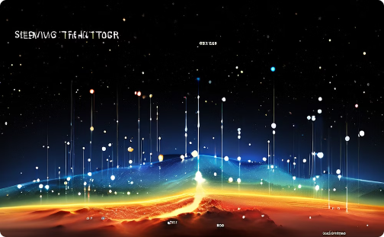


Spatial Distribution of Stellar Properties
Temperature Distribution
Mass Distribution
Luminosity Patterns
Variation of stellar temperatures across the galaxy.
Spatial patterns of stellar masses throughout the Milky Way.
Distribution of star brightness across galactic regions.

Slide 21
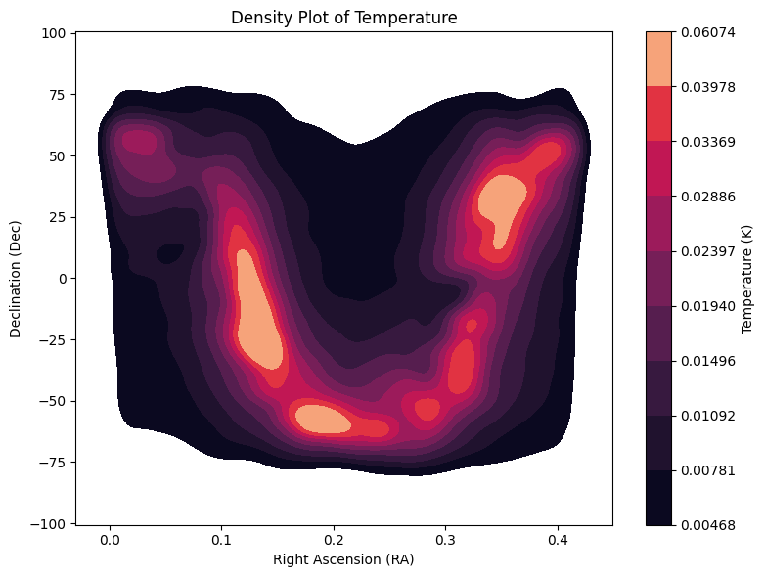
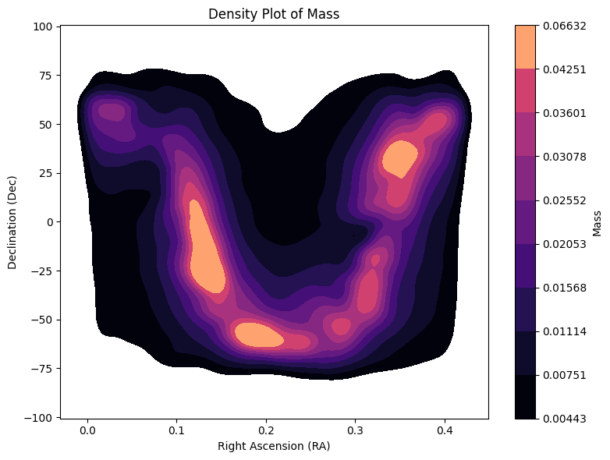
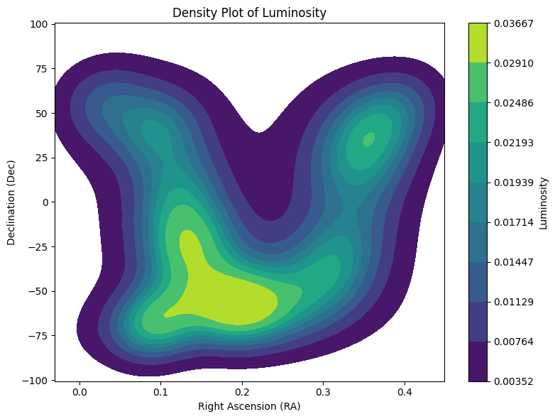
Spatial Distribution of Stellar Properties
Temperature Distribution
Mass Distribution
Luminosity Patterns
Variation of stellar temperatures across the galaxy.
Spatial patterns of stellar masses throughout the Milky Way.
Distribution of star brightness across galactic regions.

Slide 22
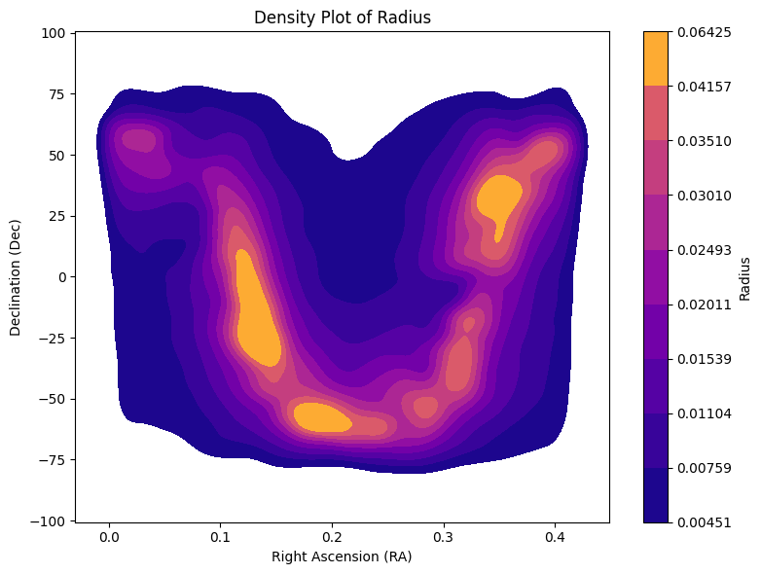
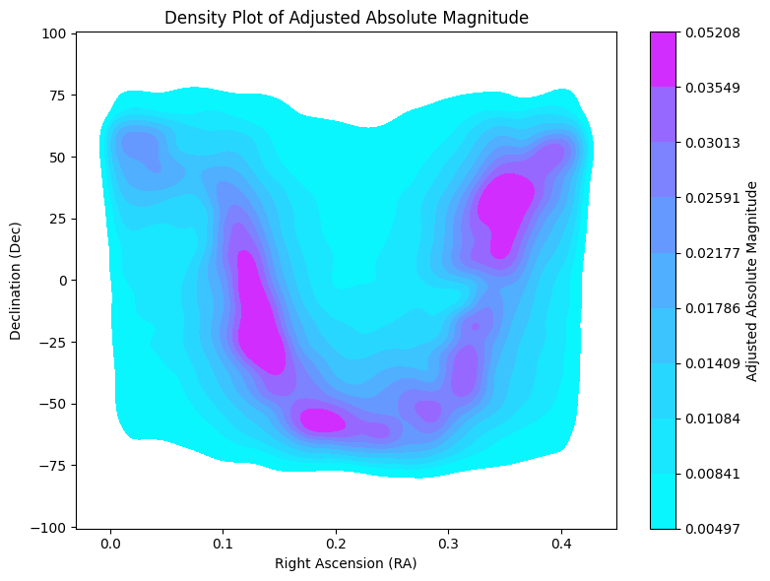
Spatial Distribution of Stellar Properties
Radii Distribution
Patterns in Absolute Magnitude
Spatial patterns of stellar radii throughout the Milky Way.
Distribution of star brightness across galactic regions.

Slide 23
Key Findings from Exploratory Data Analysis
1
Sample Size and Data Cleaning
Final sample size of 2,491,418 stars after handling missing data. Deletion of entries with missing variables did not impact data representativeness.
2
Distribution Analysis
Significant non-normal distributions observed for all key variables. Box-Cox transformations reduced skewness and kurtosis but did not achieve normality.
3
Spectral Class Distribution
Most common classes were A (1,085,220 stars) and F (835,044 stars), followed by B, G, K, M, and O, reflecting the natural variation of stellar populations.
4
Correlation and Spatial Analysis
Strong positive correlation found between mass and luminosity. Spatial distribution analysis revealed distinct patterns, reflecting the structure of the Milky Way.

Slide 24

Conclusion and Future Directions
The exploratory data analysis revealed valuable insights into the distribution and relationships among key stellar properties in the AT-HYG database. Despite challenges posed by non-normal distributions, the analysis highlighted the complex and varied nature of stellar populations. The findings from the spectral class distribution and spatial analysis align with known astronomical phenomena, reinforcing the dataset's representativeness and reliability. Future research could focus on more detailed spatial analyses, investigation of rare stellar types, and integration with other astronomical datasets to further our understanding of galactic structure and evolution.
1
Expanded Spatial Analysis
Conduct more detailed investigations of stellar property variations across different galactic regions.
2
Rare Stellar Types
Focus on the characteristics and distribution of less common spectral classes like O and M stars.
3
Data Integration
Combine AT-HYG data with other astronomical datasets for a more comprehensive galactic study.

